Slide 1

ML - Mini Project
Machine Learning Model To Predict Loan Defaulters For L&T Financial Service
-Pydisetty Hruthik(21125892014)

Slide 2

L&T Financial service
L&T Finance Holdings Limited is a holding company. The Company offers a range of financial products and services across the corporate, retail and infrastructure finance sectors through its wholly owned subsidiaries. It operates primarily in the business segment of investments activity. Its product portfolio across four business groups includes retail finance, which includes construction equipment finance, transportation equipment finance, rural products finance, rural enterprise finance, micro finance and financial products distribution; corporate finance, which includes corporate loans and leases and supply chain finance; infrastructure finance, which includes project finance and corporate loans, financial advisory services and equity investments, and investment management.

Slide 3
Challenges & About The Project
Finance is a field that is concerned with the allocation (investment) of assets and liabilities over space and time, often under conditions of risk or uncertainty. Finance can also be defined as the art of money management. Participants in the market aim to price assets based on their risk level, fundamental value, and their expected rate of return.
The dataset consists of customer information of L&T financial services. It is a finance dataset, which consists of customers demographics, loan disbursed, asset cost being purchased and the customers previous account and loan history. The dataset also consists of the state and branch id of L&T from where the loan was disbursed, the customer’s account history. It also contains the CNS score and score description provided by the Credit Bureaus of India.
It is a challenge for any financial services to target the right people for disbursing the loan. The credit team must analyse various details like CIBIL score, payment history (if available), credit history, geographical location, profession, income, age, education etc. of the customers. This will help in understanding whether the person can pay back the loan amount. Which in turn reduces its NPAs and increases the profitability.
You need to assess what data is available and perform some exploratory and descriptive analytics to identify interesting and useful patterns, trends, and insights.

Slide 4
Why loan default prediction?
The great risk of giving a loan to any financial institution is not being able to recover the loan amount from the consumer within the estimated time frame. Before lending money to a customer, the institution should check his or her credit score. A credit score is a form of the algorithm in which the customer's prior data is sent into the algorithm, which then calculates and provides a credit score that aids in the loan being granted to the proper consumer. When a consumer is unable to return the debt within a reasonable time limit, the financial institution suffers. In order to deal with it, we're developing a machine learning model that learns and predicts when a new customer may default. Or not. This may also help in fraudulent detection which decreases the risk.

Slide 5
Variable Name | Description
Loan_Id | Unique Loan id
Disbursed_Amount | Amount of Loan disbursed
Asset_Cost | Cost of the Asset
LTV | Loan to Value of the asset
Branch_Id | Branch where the loan was disbursed
City_Code | Code representing City
State_Code | Code representing State
Postal_Code | Postal code of the area
Date_of_Birth | Date of birth of the customer
Employment_Type | Employment Type of the customer (Salaried/Self Employed)
DisbursalDate | Date of disbursement
Region_ID | Code for region of disbursement
MobileNo_Avl_Flag | If Mobile no. was shared by the customer, then flagged as 1
Aadhar_flag | If Aaddhar was shared by the customer then flagged as 1
PAN_flag | If PAN was shared by the customer then flagged as 1
VoterID_flag | If voter id was shared by the customer then flagged as 1
Driving_flag | If DL was shared by the customer then flagged as 1
Passport_flag | If passport was shared by the customer then flagged as 1
PERFORM_CNS.SCORE | Bureau Score
DELINQUENT.ACCTS.IN.LAST.SIX.MONTHS | Number of delinquent accounts in the last six months
CREDIT.HISTORY.LENGTH | Credit history in terms of years
NO.OF_INQUIRIES | Number of inquiries made by the customer
Loan_Default (target variable) | Payment default in the first EMI on due date
Data Dictionary of Dataset

Slide 6
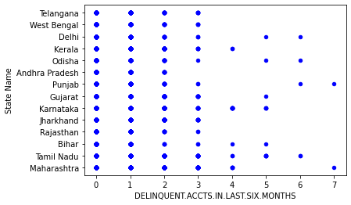
Data Visualization

Slide 7
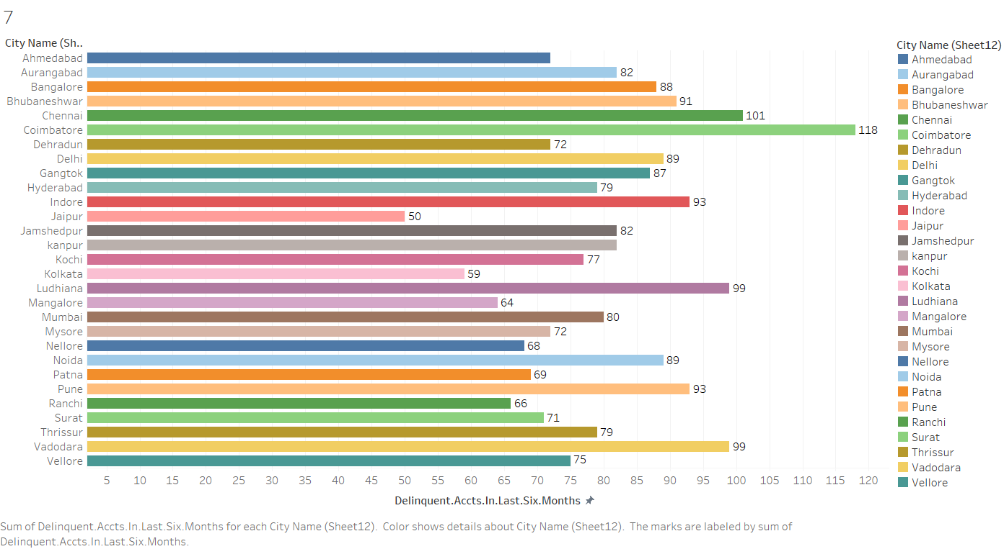

Slide 8
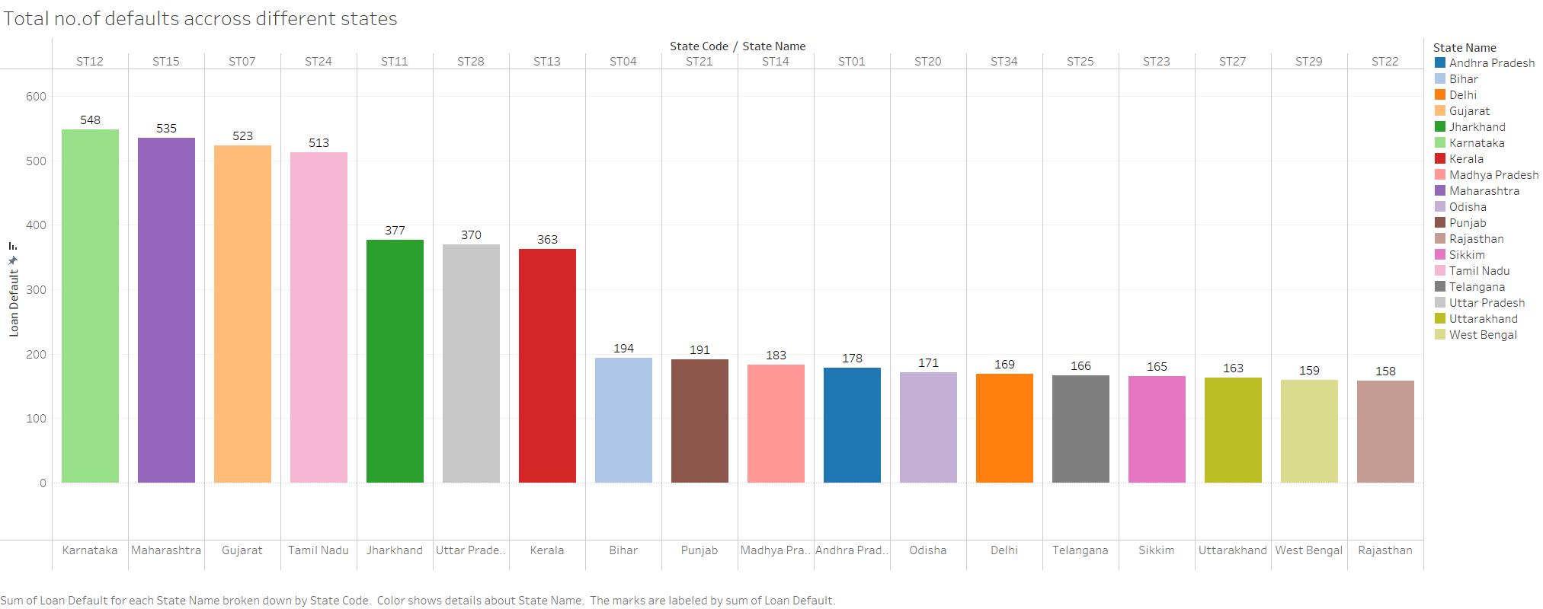

Slide 9
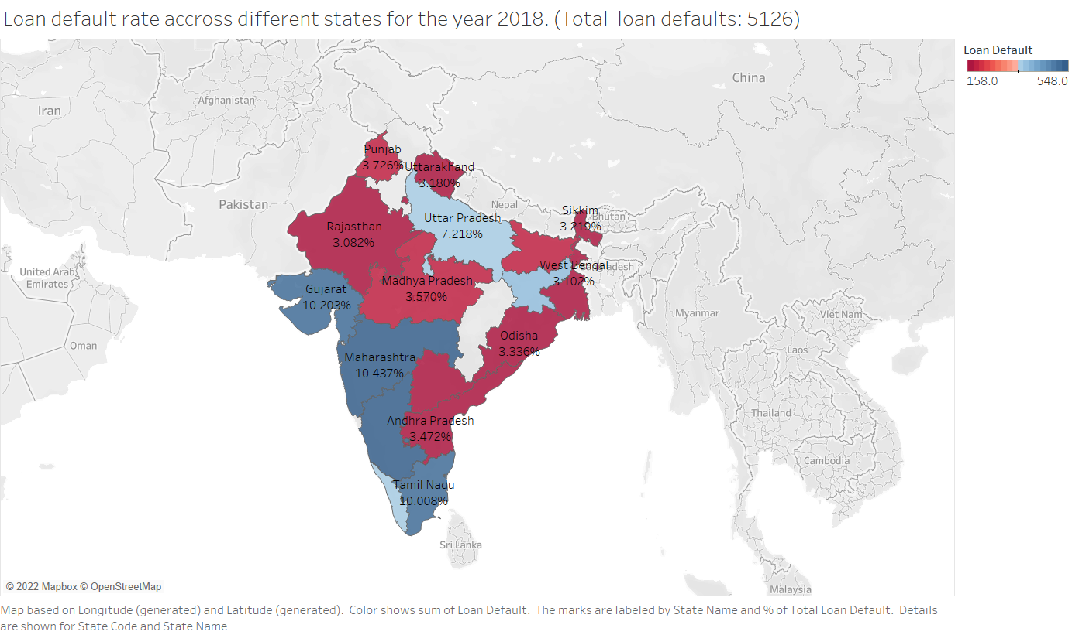
Loan default rate across different states for the year 2018. (Total loan defaults: 5126)

Slide 10
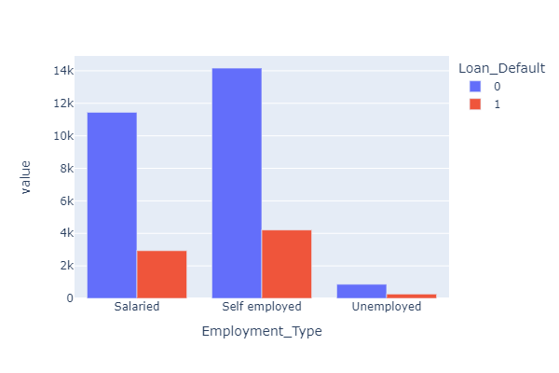
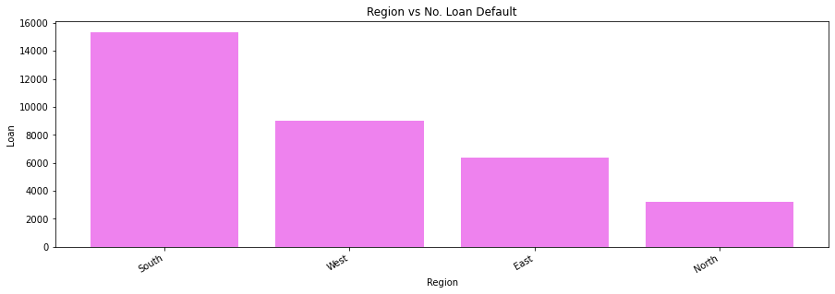
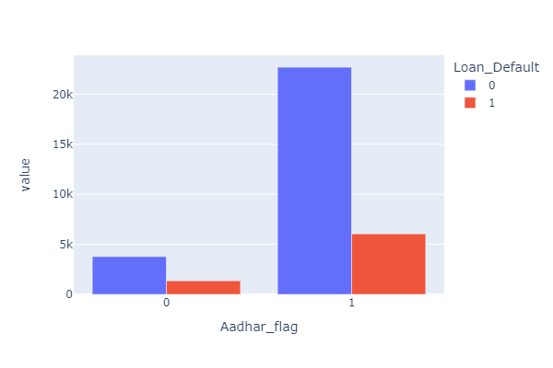
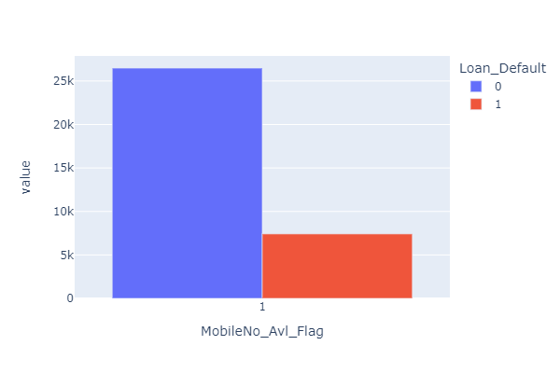

Slide 11
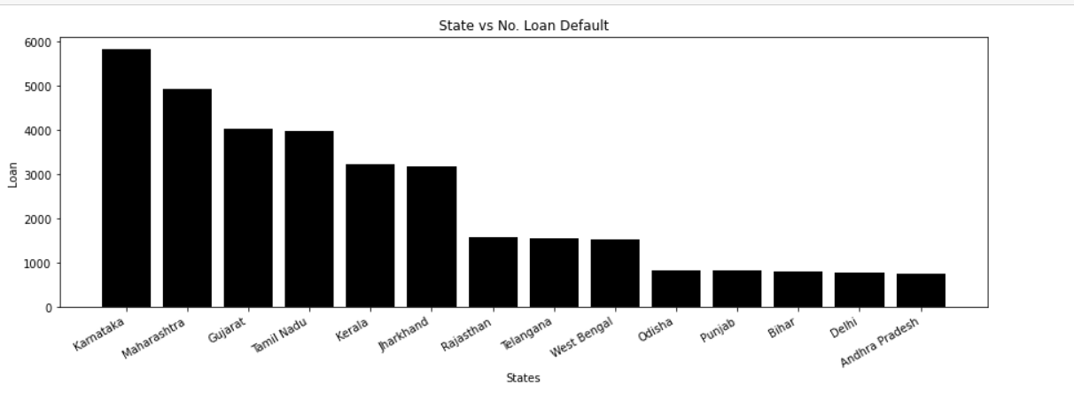
Karnataka has the highest no of customer defaulters proceeded by Maharashtra, Gujarat and Tamil Nādu.

Slide 12
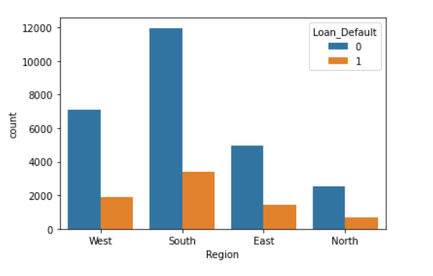
Here, we see the default rate across the different regions. South region has more no of default rate followed by west region.

Slide 13
Building the model
Drop the unwanted columns from the dataset i.e 'State_Name','Postal_Code_x','State_Code_x','City_Name_y','Region_Name’, 'PAN_flag','Driving_flag','Passport_flag','Employment_Type','City_Code', 'Date_of_Birth', 'DisbursalDate', 'CREDIT.HISTORY.LENGTH', 'Region_ID', 'State_Code_y', 'City_Name_x', 'Postal_Code_y', 'Region', 'State Name’
Dropped the duplicated columns
Imputed mean with missing values
With the shape of 33902 columns and 27 rows the dataset is cleaned and ready for the model(EDA & Data Manipulation)
Dataset is converted to “l&t_loan_default.csv“ for the Data Visualization in tableau
Statistical Hypothesis Techniques are applied to dataset Test of Normality, Independent Samples test, Test of Proportion, Chi Square test
Data split as 80% and 20% for Training and Testing data set
Models used: Linear Regression, Logistic Regression, Random Forest Classifier.

Slide 14
How good is the model?
Our main objective by trying different ML are to increase the accuracy score of the models and we’ve achieved this by with Random Forest Classifier model of 81% accuracy, but the precision score has been compromised.
As, our data set is somewhat imbalanced it will lead to a bias. So, that’s we applied SMOTE technique as a solution.
The limitation of this model is that the data set only consists of transactions done in a single year i.e., 2018. If were given data set consists of transactions of at least 2years then the model could have predicted good accuracy and precision score. It would be good practice to grant loans to people with good credit score to minimize the risk of defaulting.

Slide 15
Conclusion
The problem statement asks us to calculate the likelihood of a loanee/borrower defaulting on a loan. As a result, in addition to predicting whether a person is a defaulted or not, we must also predict the likelihood that a person will default on the loan.
As a result, we used AUC-score, F1-score of 1's, and Binary Log Loss as performance metrics to assess model performance.
All models give significantly lower F1-scores when SMOTE is not used (1s). This problem has been resolved by the use of SMOTE (Though the f1-scores can be controlled by selecting the appropriate threshold from the ROC curve).
Looking at the performance metrics of various models in the table above, we can see that Logistic Regression with SMOTE performs extremely well when compared to other models. It produces good AUC scores (without overfitting) and the best F1-Score (1). When compared to other models, the Binary log loss is slightly higher.
Random Forest Classifier with SMOTE is the next best model. AUC scores show that it is overfitting when compared to Logistic Regression. It does, however, have a good F1-score(1), which is slightly lower than Logistic Regression. When compared to Logistic Regression, it has a better(lower) binary log loss.
Random forests model seems to have better accuracy compared to other models.
Using this model will help the institution in predicting the loan defaulting with a 80% of confidence.

